Slide 1

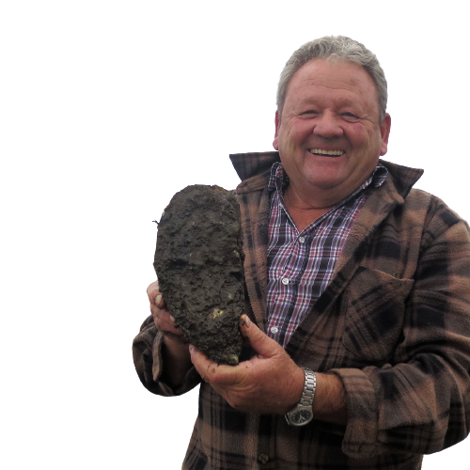
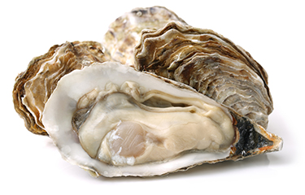
2021 STEM INSTITUTE AT PACE UNIVERSITY- Final Presentation
Team 6- Daniel A, Owen C, John L, Aditya P, Sohum P, and Juan R
Notes:
Include experience (how have you enjoyed the program), introduce yourself, insights toward our research question, how we accomplished, correlation or relationship variables John

Slide 2
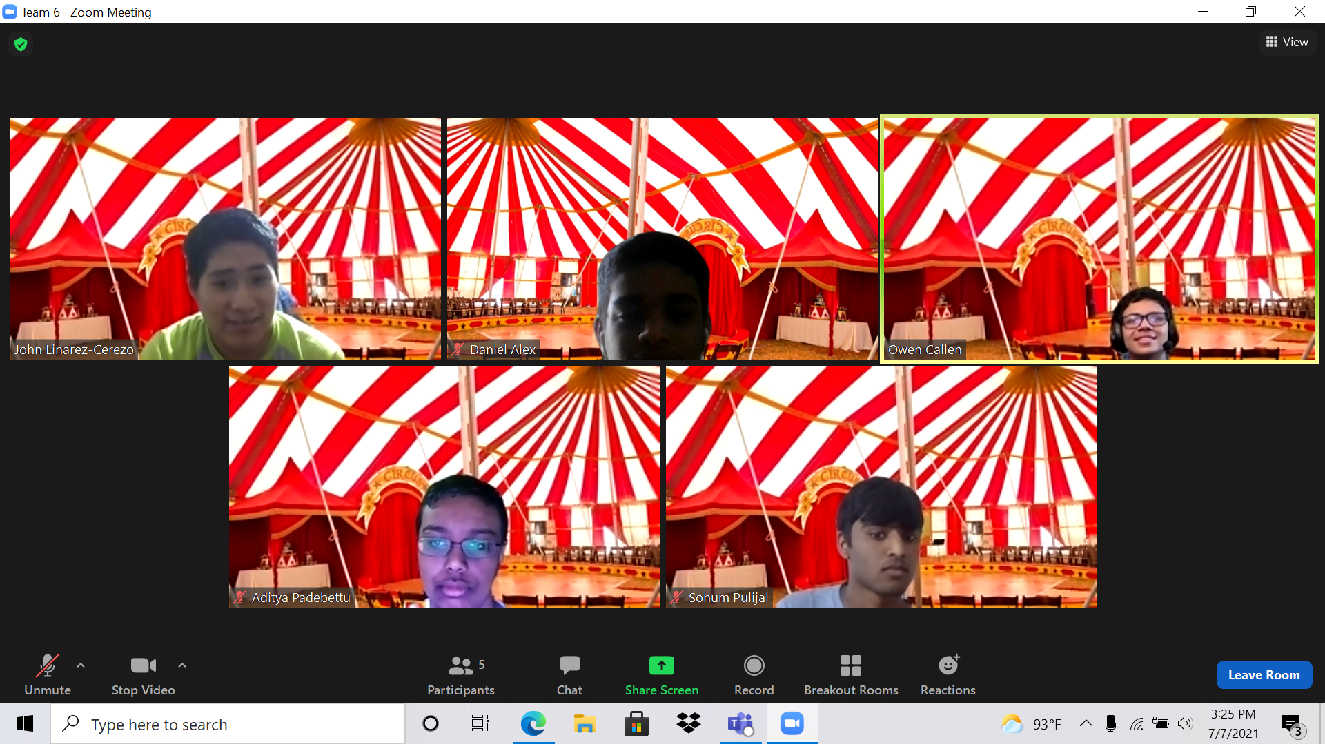
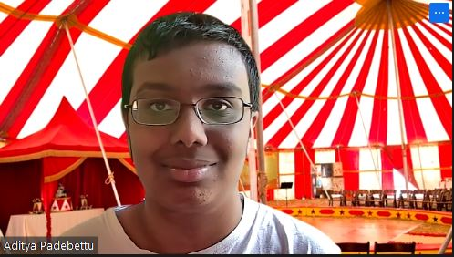
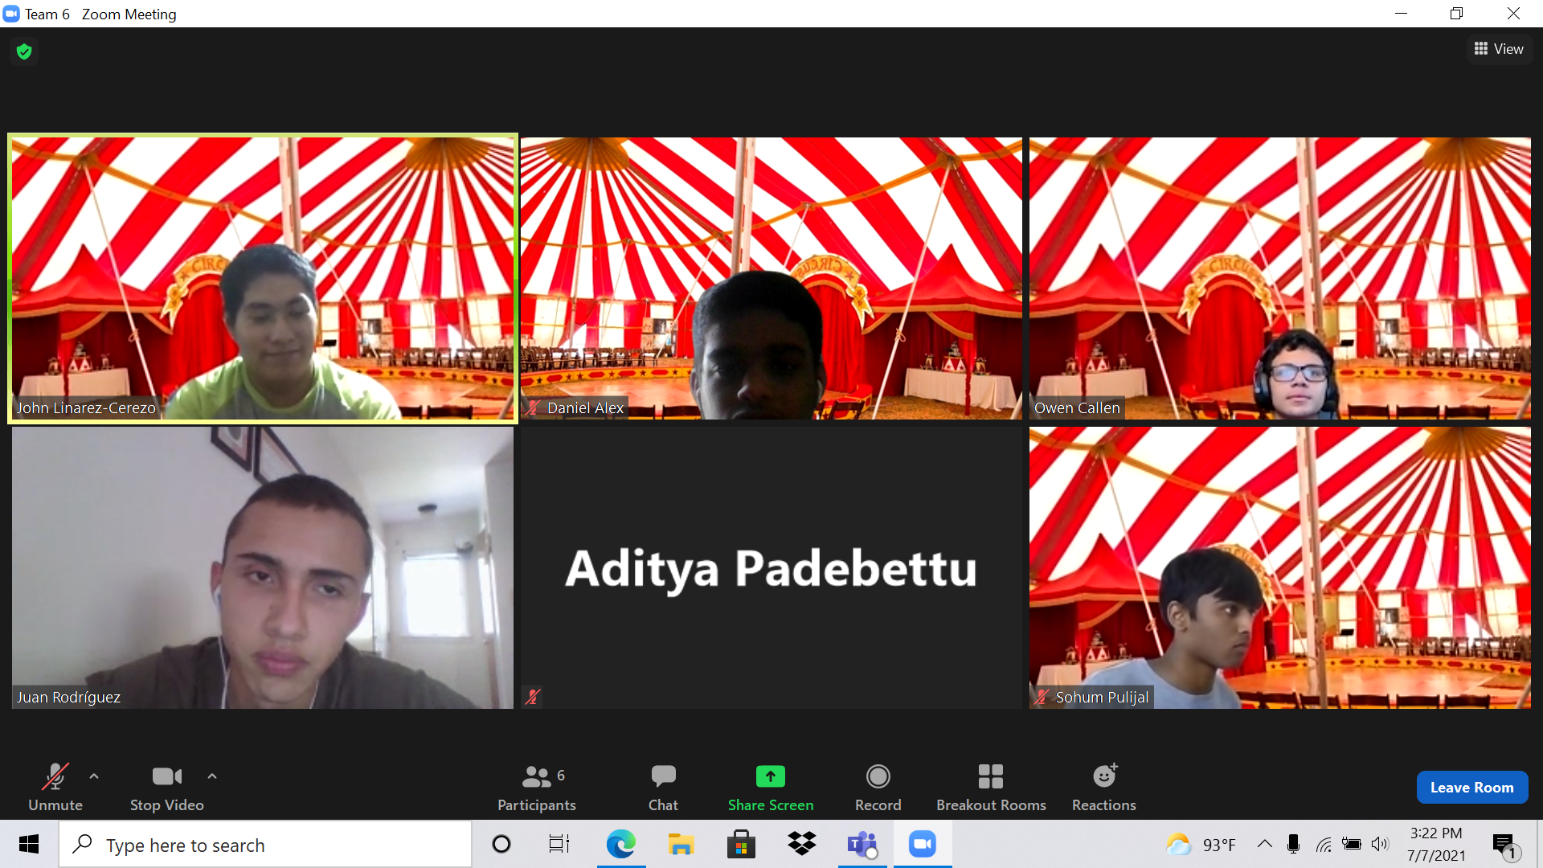
Meet The Entire Circus 🤡
John
Daniel Alex 🤡
Owen Callen 🤡
John Linarez 🤡
Aditya Padebettu 🤡
Sohum Pulijal 🤡
Juan Rodriguez 🤡
Notes:
John

Slide 3

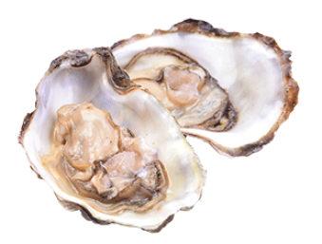
Insights (Data/Scientist)
Sohum
BOP Scientist Anna Fraioli
Bigger Oysters filter more water
Oysters have no brain
Oysters need salt water
Throughout Program
The basics of Python
Arithmetic operations and data framing in Python
Turbidity exists
Sorting data using python
Notes:
Sohum

Slide 4
Our Research Question
Daniel
How do toxins and poison affect oysters (Shell height, pH, temperature)?
Is more acidic and turbid water significant to an oyster growth and shell height?
From what we have observed, some oysters aren’t as large.
Why are different factors affecting oysters’ growth?
The oysters are growing up in different locations that contain different conditions and climates.
Why do they grow up in different conditions?
Because they look for the best place to develop and grow the oysters.
Notes:
Daniel

Slide 5

Research Question Hypothesis
Daniel
d. How do oysters know the best location for growth?
Because it has the environmental conditions such as pH, temperature, and nutrients to grow and develop.
e. What environmental factors are ideal for oyster growth?
We hypothesize that factors such as a higher pH of 7.5 and 8.4 and a higher temperature between 20℃ and 25℃ allow for the great growth of the oyster.
Notes:
Daniel

Slide 6

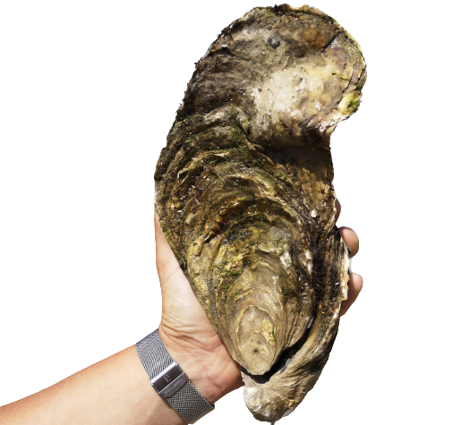
Why Do Shell Heights Matter?
Sohum
Oyster’s filtering ability
Generates pseudo feces
Larger oysters produce more pseudo feces
Based on this…
Larger shell heights may indicate that oysters thrive better.
pH, temperature, and turbidity cannot be ignored
Notes:
Sohum

Slide 7
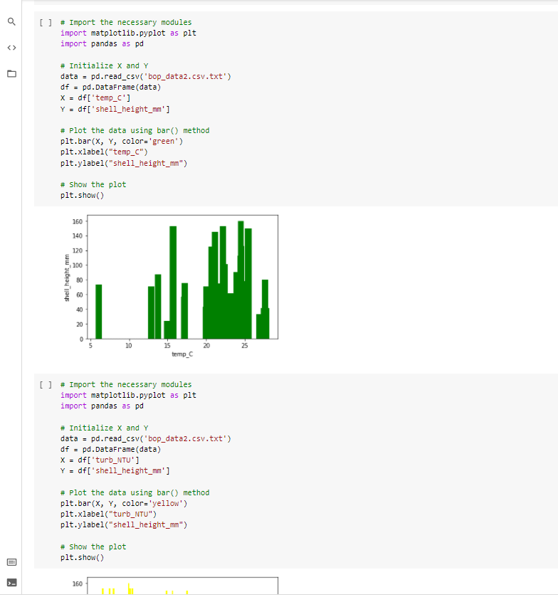
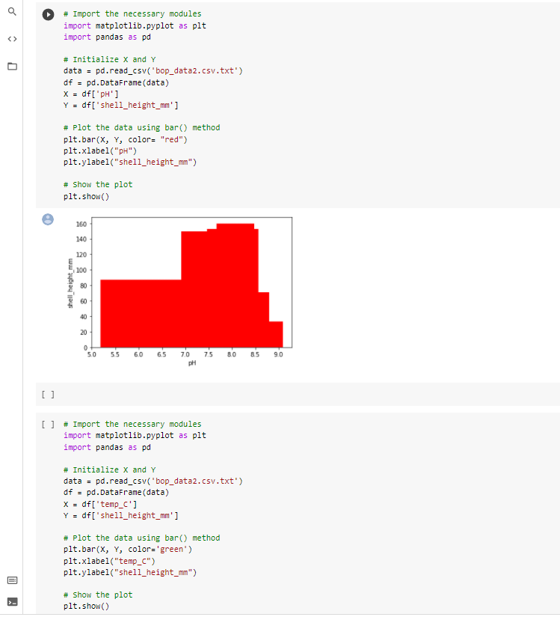
Here is our code
Owen
Notes:
Owen
Code Links
https://colab.research.google.com/drive/1H3VqyIxjF3HyUs6PQYoRXa5J0-hHNsXg#scrollTo=xlWvhEnedaVA
https://colab.research.google.com/drive/1L4Ru_a8I5FEliQ_L6BHfZsbLVUAg-vO6?usp=sharing#scrollTo=sHWsSsi0l8Og

Slide 8
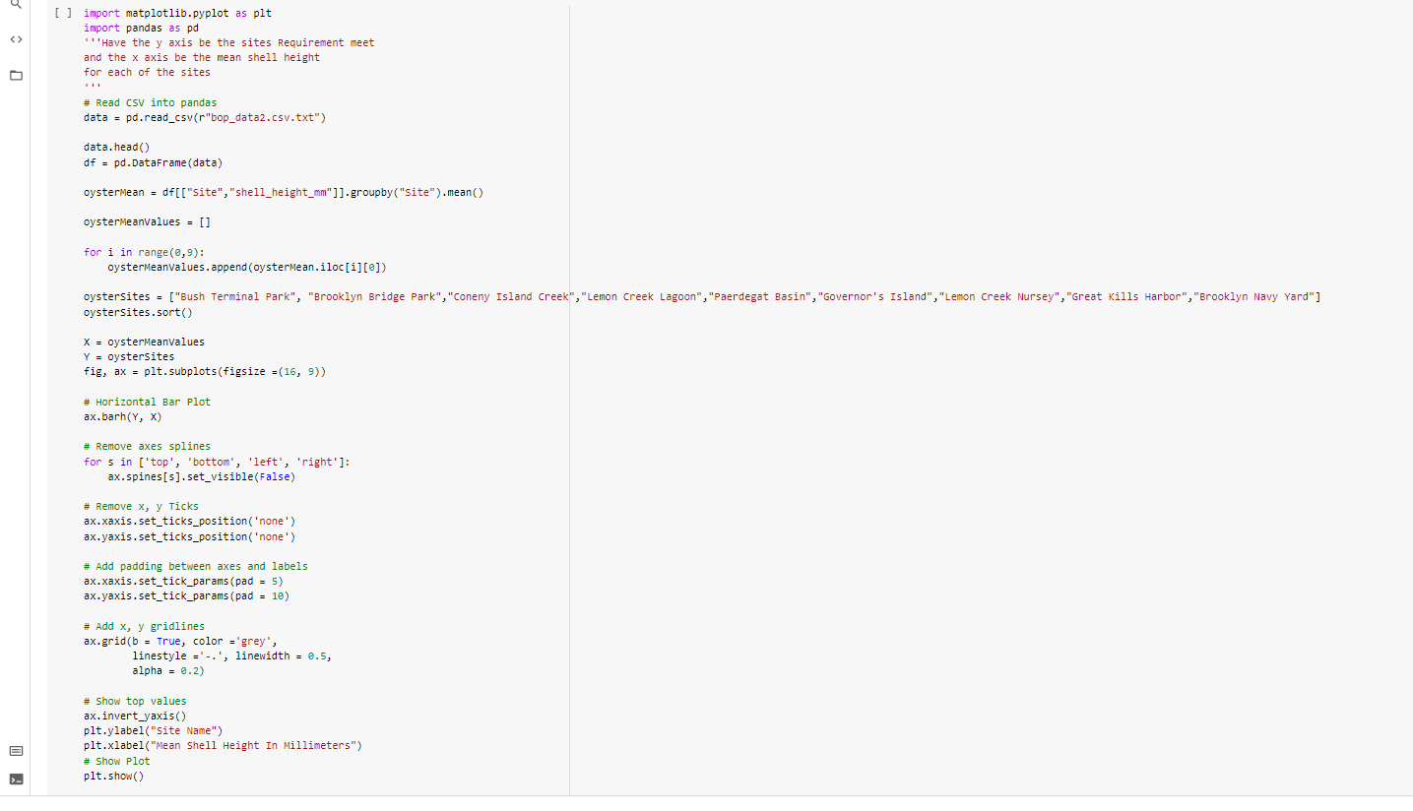
Code Cont.
Owen
Notes:
Owen

Slide 9
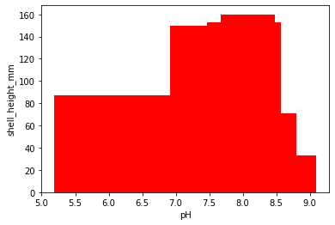
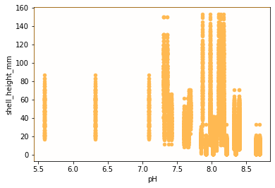
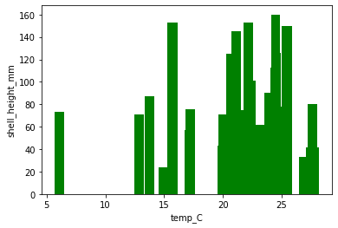
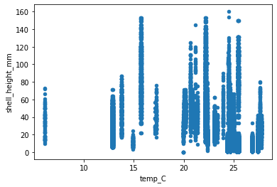
Juan
Notes:
Juan
Sohum Backup

Slide 10

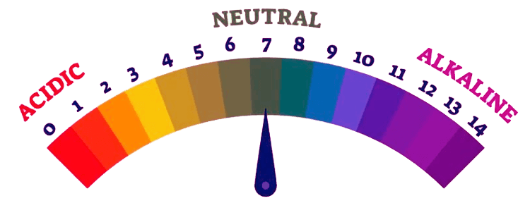
Assumptions Based On pH And Temperature
Sohum
Temperature and pH directly affect growth
150-160 mm shell heights found between 7.0-8.5 pH
Between 20℃ and 25℃ shell height is 140-160mm
However...
Data from sites, pH, and temperature show a different story
Notes:
Sohum

Slide 11
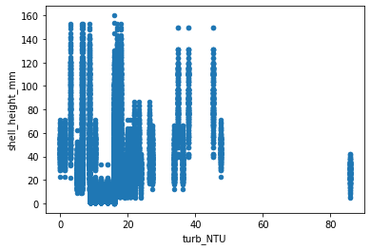
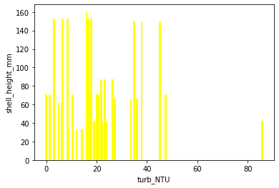
Assumptions Based On Turbidity
Sohum
0-50 NTU shows most signs of oyster growth
Turbidity does not appear to have a big effect on shell height
However...
Sites data shows more profound effect.
Notes:
Sohum

Slide 12
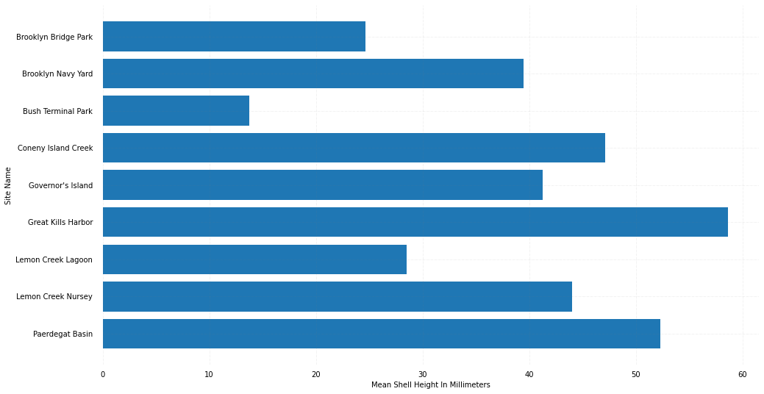
Site and Mean Shell Height
Juan
Notes:
Juan
John backup

Slide 13
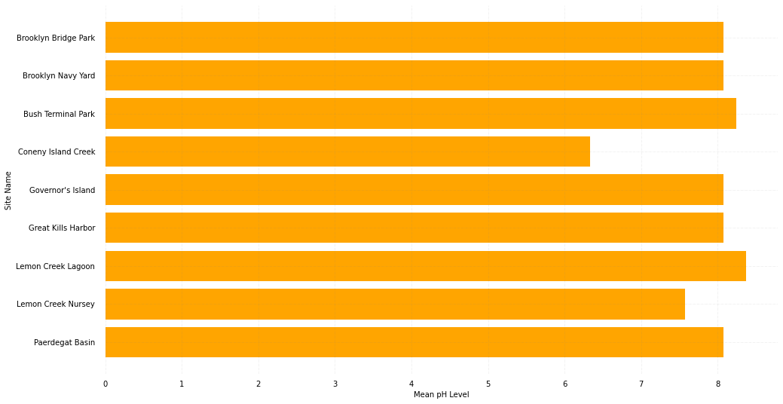
Site and Mean pH Level
Juan
Notes:
Juan
John back up

Slide 14
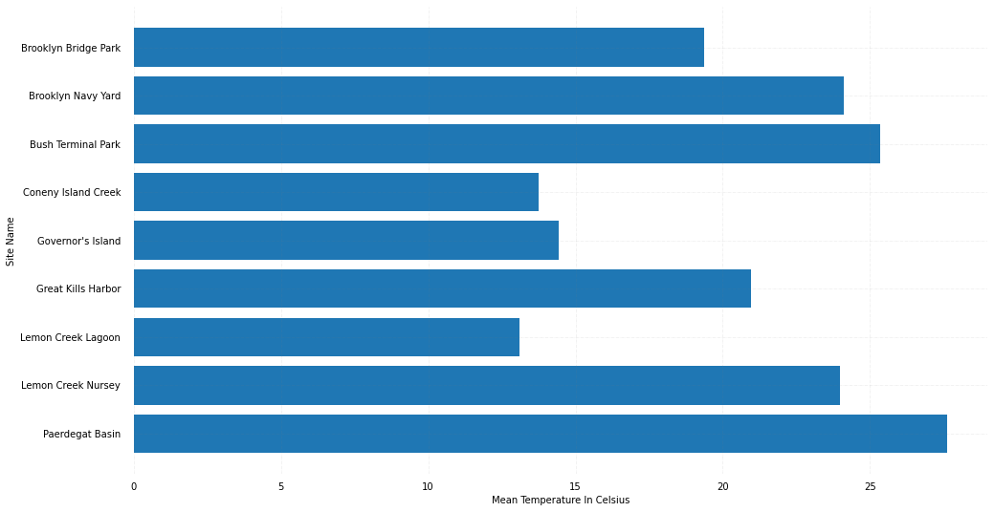
Site and Mean Temperature
John
Notes:
John

Slide 15
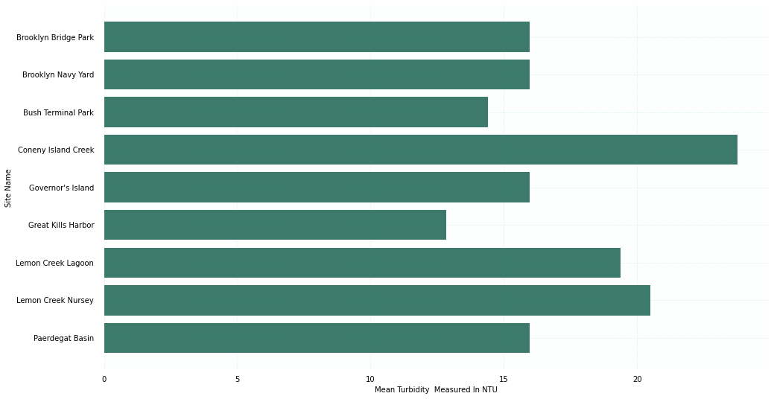
Site and Mean Turbidity
John
Notes:
John

Slide 16
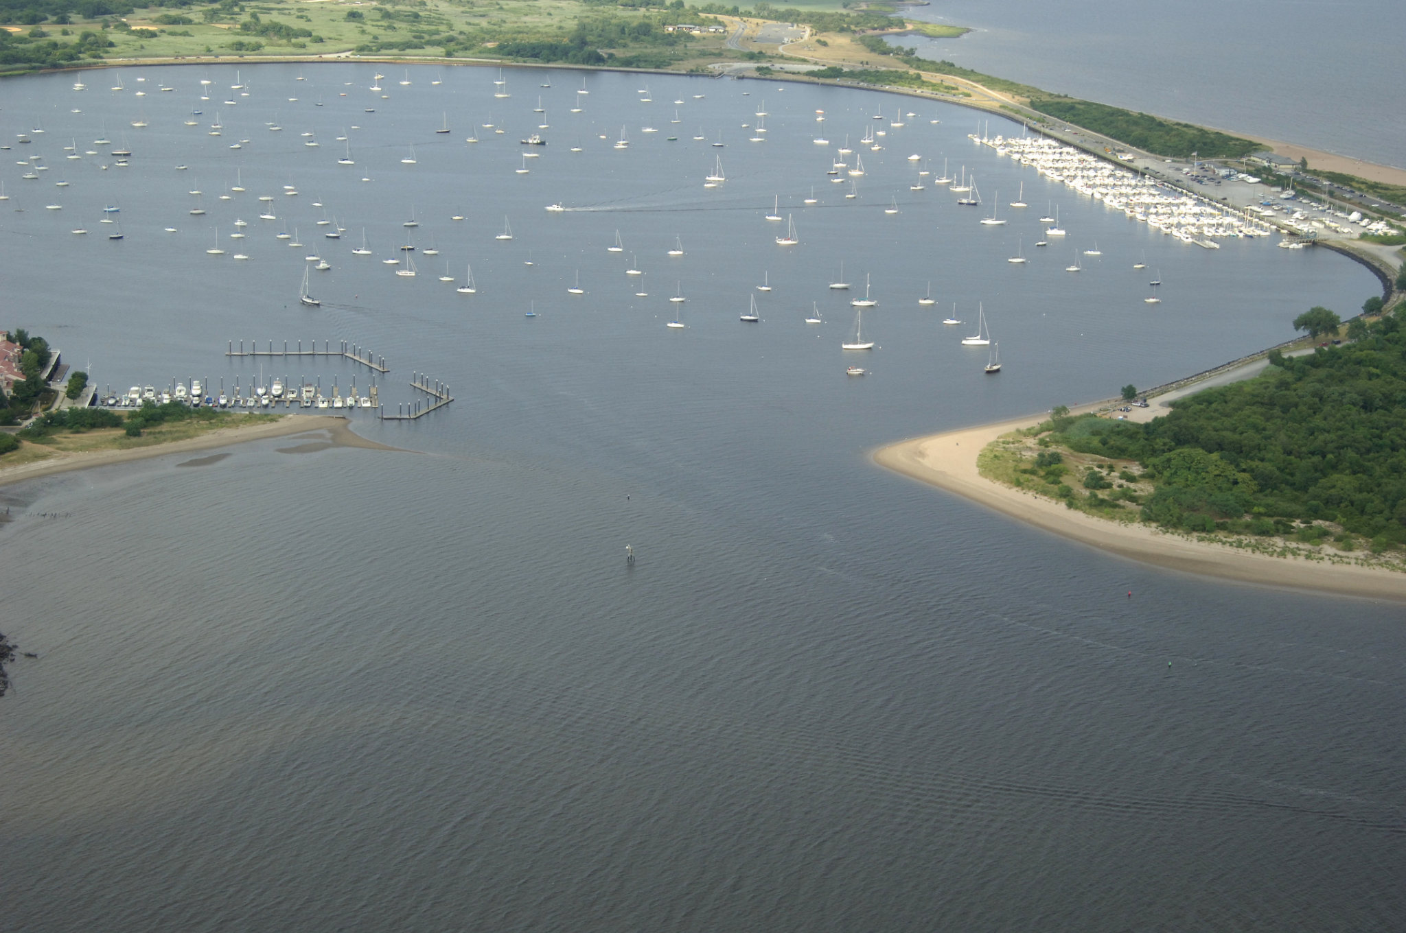
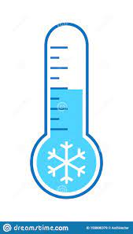
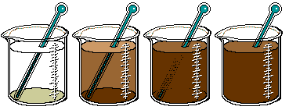
Findings Based On New Data
Owen
“Ideal” Site For Oyster Growth
Great Kills Harbor
However….
Uncertainty with factors
Ex: Coney Island Creek
Notes:
Owen

Slide 17
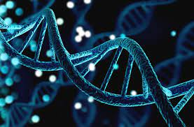

In Conclusion
Owen
No clear correlation between pH, turbidity, or temperature to the size and growth of the oysters.
Hypothesis proven incorrect
May be more factors affecting oyster growth (ex: local ecosystem or genetics)
Notes:
Owen
We hypothesize that factors such as a high pH of 7.5 and 8.4 and a higher temperature between 20℃ and 25℃, are things that allow a correct development and great growth of the oyster.

Slide 18
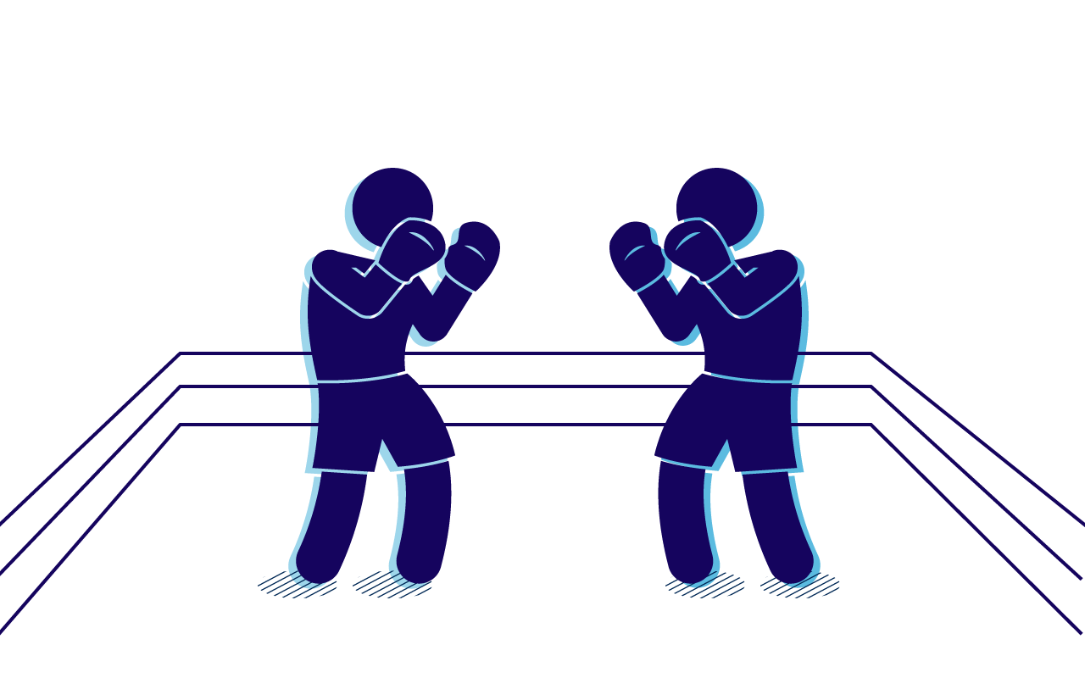
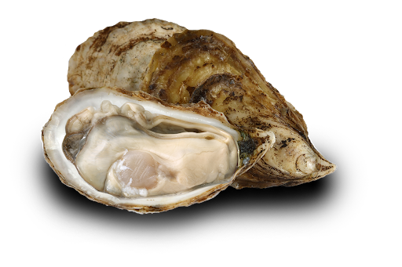
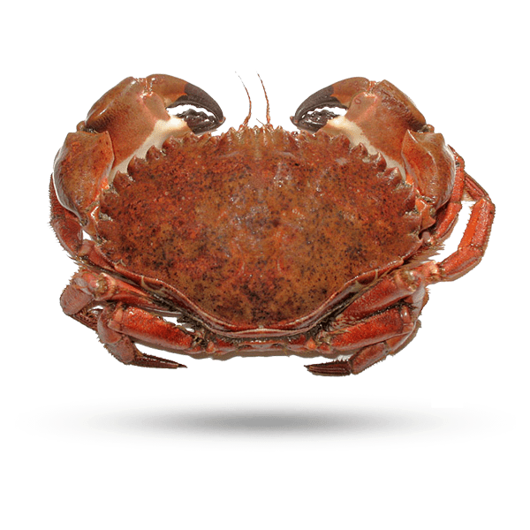

In Conclusion Cont.
Juan
More data is necessary to find other optimal conditions
Reproduction of the oysters
Lifespan
Other species or predators present in the sites
Notes:
Juan
Owen backup

Slide 19

Experiences While Meeting with Special Guests
Daniel
Agata Poniatowski and Dr. Stephen Gosnell:
Learned more about oysters and their functions
Important roles in life (life cycle, filtering water)
Josh Gordon from Google:
Deep learning applications, and neuronal system
Training models
App Figures Panel:
What it’s like to work in data analysis
Impact to small/large business
Notes:
Daniel

Slide 20
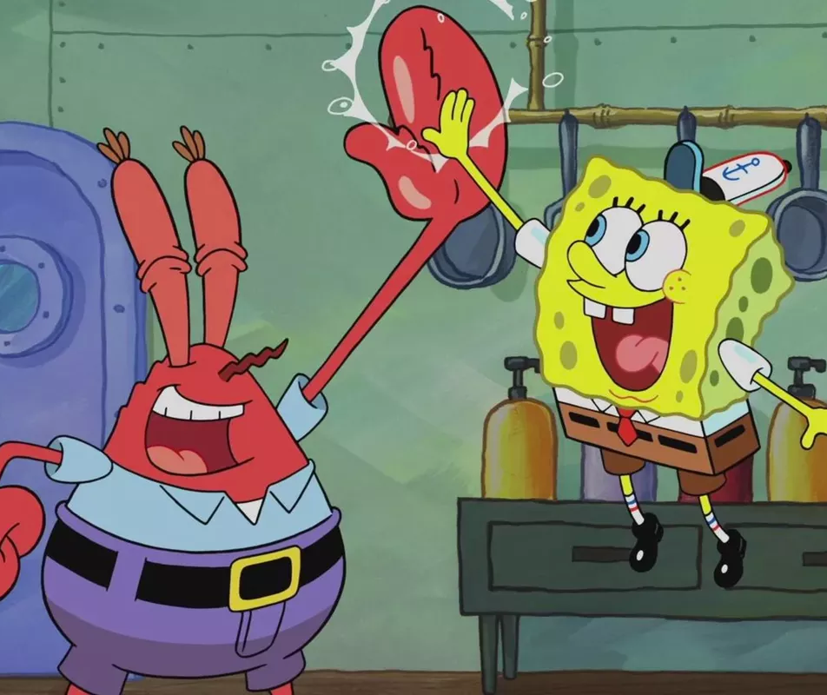

Our Experiences Throughout This Program
Notes:
Everyone

Slide 21
Our Experiences Throughout This Program
Daniel- I have enjoyed this program so much since I was able to learn a lot about Python and data science as well as oysters and even interacting with all of my mentors and friends.
Sohum- I have had fun learning the mix of data science, coding, and oyster biology and behavior that this STEM camp taught me, as well as the great people I got to meet.
Aditya- I had a great time learning coding and data science with Python, and analyzing real data sets from the Billion Oyster Project.
John- I signed up for analyzing a cool dataset and learning data science. I got exactly what I wanted (:
Juan- I have learned a lot since I started the program I can learn about reading and data organization, together with my group I have learned a lot and I had fun. ;)
Owen- I had a great time working with my group and learned a lot from the speakers as well as my peers.
Notes:
Everyone

Slide 22

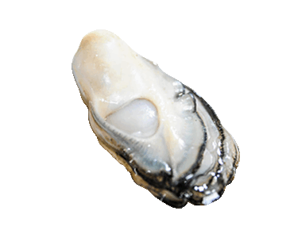
Notes:
Everyone

